Slide 1
Blastomycosis

Slide 2
Clinical Presentation
Patient is a 36 year-old African American male from Baton Rouge, La. He was admitted into the ER suffering from shortness of breath and productive cough for two weeks. Ulcerative lesions are found on the patient’s left calf. Patient reports pain located at the knees. HIV test was positive. Chest x-rays and tissue biopsy were performed. The tissue biopsy of the ulcerative lesions showed fungal organism that suggest Blastomyces dermatidis. In addition, a sputum test was performed and found fungal organism present confirming Blastomyces dermatidis.
Patient began working on a construction site along the river about two months ago. Reports
of patients suffering similar symptoms have been found in the past year in the same area
that this patient worked at. Officials are testing the soil to determine if conidia of
Blastomyces dermatidis are present.
Patient was put on itraconazole for two weeks. Initial progress was slow but the fungal
infection eventually cleared up. Lesions are beginning to heal and patient reports that he
no longer have trouble breathing. His coughs are reduced as well. Long-term treatment with
itraconazole is required in order to prevent a reoccurrence.

Slide 3
What is Blastomycosis?
Blastomycosis is a fungal infection caused by a fungus called Blastomyces dermatidis
It is found in moist soil, specifically in rotting vegetation
  It is contracted through inhalation, and it starts by infecting the lungs
  From the lungs it disseminates into the bloodstream and lymphatics where it spread to the rest of the body
    Also involves the skin, joint, bones, organs, central nervous system
  weakened immune systems, such as those with HIV or who have had an organ transplant
Uncommon but can deadly in adults

Slide 4
Clinical Manifestation
Respiratory Signs of Blastomycosis
Flu like symptoms
fever
chills
myalgia
headache
nonproductive cough
Chronic illness
low-grade fever
productive cough
fatigue
night sweats
weight loss
Rapidly progressive, and severe disease, eg, multilobar pneumonia or ARDS
fever
shortness of breath
tachypnea
hypoxemia
finally hemodynamic collapse
Acute illness analogous to bacterial pneumonia
high fever
chills
productive cough
pleuritic chest pain
mucopurulent or purulent sputum

Slide 5
Clinical Manifestation
Extrapulmonary manifestations present in 25-40% of cases
Cutaneous lesions
verrucous or ulcerative
asymptomatic
Osteoarticular lesions
bone or joint pain
soft-tissue swelling
involvement of any bone may be involved
most common sites
  vertebrae and pelvis
Genitourinary
prostatitis and epididymitis
asymptomatic or painful urination
Central nervous system
Intracranial abscesses
Epidural abscesses
meningitis
Other organ sites reported include the eye, liver, breast, thyroid, and adrenal gland.

Slide 6
Initial Diagnosis
Clinically, blastomycosis can be difficult to recognize even in the endemic areas where clinicians are aware of this problem.
At the University of Mississippi Medical Center (Jackson, MS), the suspected initial diagnosis of blastomycosis was only correctly suspected in 18% of 123 patients.(7)
Most Common misdiagnosis
    Pneumonia (40%)
    Malignant tumors (16%)
    Tuberculosis (14%)
Cutaneous involvement makes recognition easier, percentage of correct initial diagnosis to 64%.
Another associated disease commonly found in blastomycotic patients was diabetes mellitus (22%).
Underlying immuno-depressive conditions & diabetes mellitus (22%)

Slide 7
Diagnostic Tests
In order to make a diagnosis healthcare providers will use your history and physical condition along with diagnostic tests.
    Imaging Tests
    Chest x-rays
    Chest CT
  Lab Tests-cultures may be done to see if Blastomyces will grow from the sample
    Sputum test - culture and exam
    Urinalysis - culture
    Skin biopsy
    Tissue biopsy

Slide 8
Diagnostic Tests cont.
Blastomycosis may be asymptomatic, therefore diagnostic tests may not provide the results needed to make a conclusive diagnosis.
In order to provide a definitive diagnosis it is crucial that B dermatitidis is visualized.
  This should be done prior to doing a culture to confirm the diagnosis.
  To have an absolute diagnosis, it is important to isolate and identify the organism on a sputum culture
Skin tests are not reliable unless sample is viewed under a microscope

Slide 9
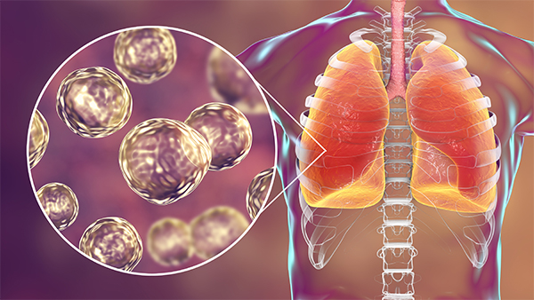
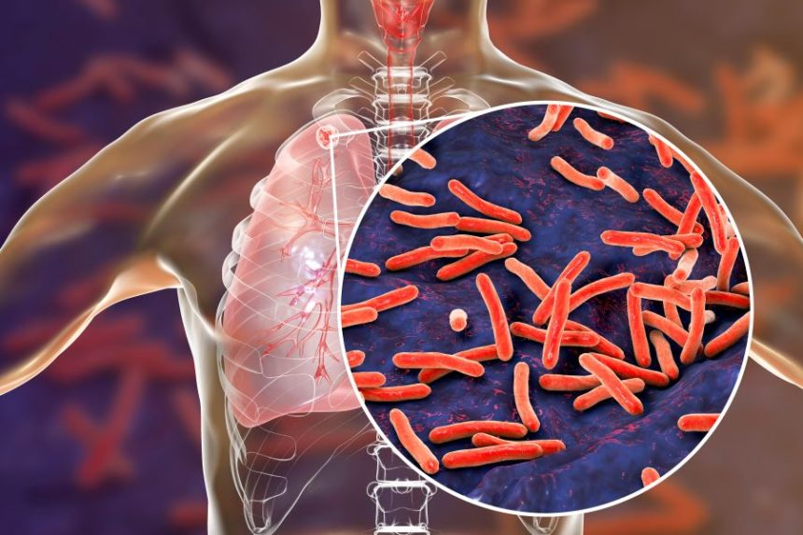
Visualization of Blastomycosis
Blastomycosis appears as round,
multinucleated yeast cells
This is unlike Mycobacterium
tuberculosis cells as they appear
elongated
Blastomycosis
Tuberculosis

Slide 10
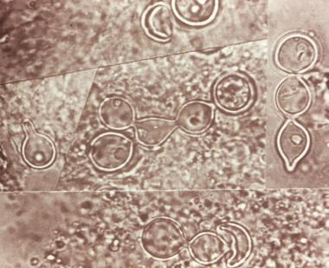
Visualization (continued)
Micro graph of a tissue from a person infected with blastomycosis
Shows large budding cells configured in chains

Slide 11
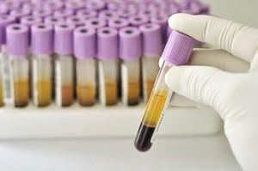
Lab test for Blastomycosis
Urine, blood, or sputum specimen used for blastomycosis
For blood, plasma specimen is collected
and mixed with heparin or sodium citrate
in a tube.
Content is centrifuged for 15 minutes
Centrifuge is pipetted into a plastic
screw cap vial.
Definitive diagnosis is done by isolating the fungus from tissue samples

Slide 12
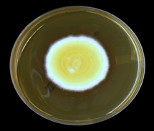
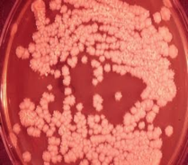
Etiology
Blastomycosis is caused by the fungus Blastomyces dermatitidis
B. dermatidis belongs to the phylum Ascomycotia and family gellomycetaceae,
The fungus is thermally dimorphic. It has a fluffy white appearance at 25 degree Celsius and appears as brown folded yeast mold at 37 degrees
B
Spore-like appearance, with fluffy white mycelium at 25⁰C
Organism cultured on blood agar at 37⁰C
D

Slide 13
Microbiologic Characteristics
Blastomycosis is dimorphic, meaning it assumes different forms depending on the temperature
The fungus exists in mold form at room temperature
It converts to yeast form when inhaled
The yeast form of blastomycosis contains 8-12 nuclei
Reproduces by single budding

Slide 14
Treatment
A doctor may recommend medicine for mild blastomycosis infection
Anti-fungal medication is used when the fungus spreads outside the lungs (7)
These include;
  Fluconazole
  Itraconazole
  Ketoconazole
  Amphotericin B may be used for severe infections.
Ongoing follow-ups with your doctor is required to avoid re-infection

Slide 15
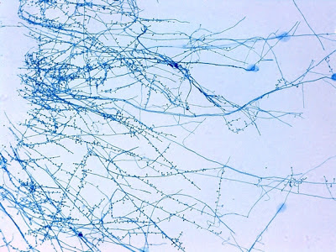
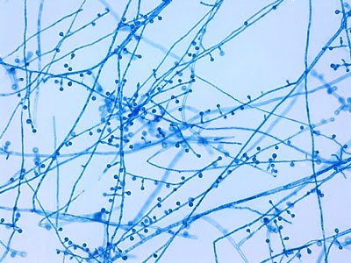
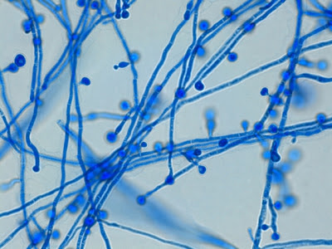
Description of the Organism and how it causes the disease
Infection occurs from exposure to conidia of B. dermatidis
  conidia: a spore produced asexually by various fungi at the tip of a specialized hypha
Inhalation of aerosolized conidia from soil are deposited into pulmonary alveoli
Conversion of B. dermatitidis to yeast occurs in the lung where the host inflammatory
response are triggered
Disease is spread to skin or other organs by yeasts that have not been phagocytized
through the blood or lymphatic system
a low power view of hyphae growing away from the point of inoculation of a slide culture
another view of the "lollipop-like" conidiophore-conidia structures extending along the length of hyphae
more is better, another photo
Notes:
BLASTOMYCES†DERMATITIDIS
PATHOGEN SAFETY DATA SHEET INFECTIOUS
SUBSTANCES
Public Health of Canada
http://dictionary.reference.com/browse/conidia
http://www.emedicinehealth.com/blastomycosis/page4_em.htm

Slide 16
Pathology
• Primary site of infection is the pulmonary system. This is ‘Pulmonary
blastomycosis’
Sub-Categories of blastomycosis are:
  Single organ system disease such as lymphatic system, liver system, skin and other organs
May also cause generalized multi-organ disease leading to end stage hemodynamic collapse
Chronic dermatologic manifestations of the disease includes cutaneous manifestations
that appear ‘verrucous’ and ‘ulcerative.’
Notes:
Cutaneous blastomycosis: a clue to a systemic disease*
Five categories of blastomycosis have been defined:

Slide 17
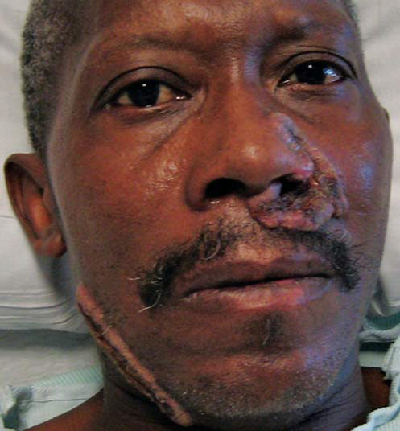
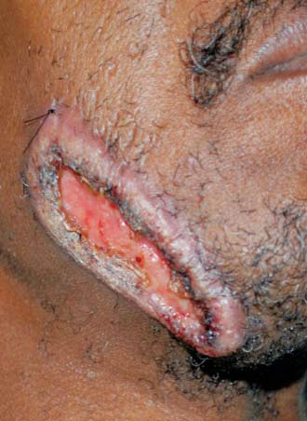
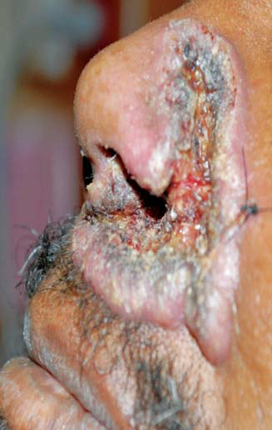
Patient with a couple of verrucous and eroded plaques on the face
Close up of lesion along right jawline
Close up of lesion beside left nasal

Slide 18
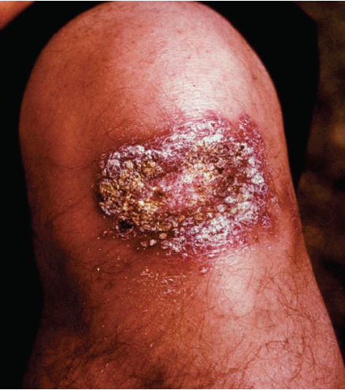
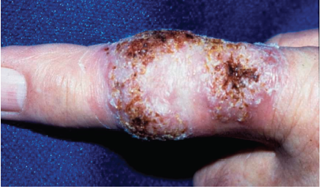
Blastomycosis Ulceration
Blastomycosis Ulceration
Primary Cutaneous Blastomycosis

Slide 19
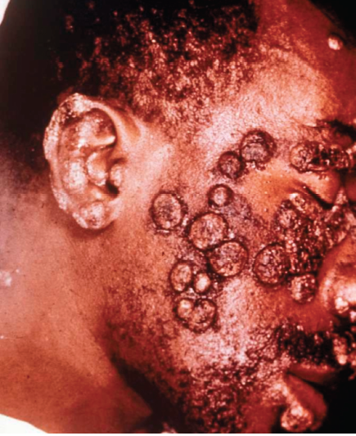
Blastomycosis Verrucous Plaques

Slide 20
Virulence factors
BAD1: 120-kDa major surface protein adhesin
  when BAD1 sticks on to our cells, the humoral and cell-mediated immune responses targets them and fights off the virulence factor
α-1,3 glucan: cell surface carbohydrate
  mask BAD1 on surface of Blastomyces dermatitidis yeast cells so immune responses do not detect them
Both are found on surface of Blastomyces dermatitidis yeast cells
It has been found that more virulent strains of Blastomyces dermatitidis possess less
BAD1 on the surface of yeast cells
Notes:
http://www.scientificjournals.org/journals2007/articles/1021.htm

Slide 21
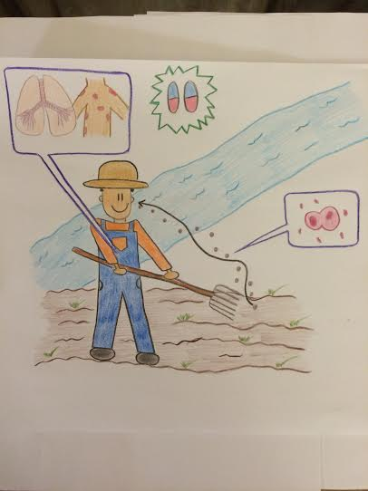
Epidemiology
Epidemic or sporadic
Found in United Kingdom, United States,
Canada, central Europe, Africa, India, and
some parts of the Middle East
Blastomycosis is more common in
North America, endemic to the Midwestern,
southeastern, and southcentral United States
along the Ohio and Mississippi rivers.
In areas where outbreaks occur, three to six cases
requires hospitalization per million
persons per year
Those who frequents or work along rivers or streams are exposed to decayed vegetation
in moist soil which increases their chance to contract blastomycosis.
Adults > Children, Men > Women

Slide 22
References
Barnes, Lauren BS, Al-Dabagh, Amir BS, BA, and Feldman,Steven R. MD, PhD Treating Rare Fungal Infections: Cutaneous Blastomycosis Volume 21 - Issue 5 - May 2013 http://www.the-dermatologist.com/content/treating-rare-fungal-infections-cutaneous-blastomycosis
Conidia. (n.d.) . In Dictionary.com online. Retrieved from http://dictionary.reference.com/browse/conidia
Davis, Charles Patrick, MD, PhD 2015, March. Blastomycosis. Retrieved on February 21, 2015 http://www.emedicinehealth.com/blastomycosis/page4_em.htm
Nguyen, Tuyet and Ortega-Loayza, Alex G. 2013, April. Blastomycosis: a clue to a systemic disease. Retrieved from https://www.researchgate.net/publication/237059549_Cutaneous_blastomycosis_A_clue_to_a_systemic_disease

Slide 23
Pathol, Ann Diagn. 2002 Jun;6(3):194-203. Blastomycosis: The great pretender can also be an opportunist. Initial clinical diagnosis and underlying diseases in 123 patients Retrieved on February 20, 1026 from http://www.ncbi.nlm.nih.gov/pubmed/12089732
Public Health Agency of Canada (2010) Blastomycis Dermatitidis. Retrieved from: http://www.phac-aspc.gc.ca/lab-bio/res/psds-ftss/blastomyces-dermatitidis-eng.php
Scalarone, Gene M. and Sestero, Christine M. (2007) Detection of the surface antigens BAD1 and α-(1,3)-glucan in six different strains of Blastomyces dermatitidis using monoclonal antibodies. Journal of Biology, 1(1). Retrieved from http://www.scientificjournals.org/journals2007/articles/1021.htm
Vyas, Jatin M. MD, PhD. 2014 Aug. MedlinePlus. Blastomycosis. Retrived February 20, 2016 from https://www.nlm.nih.gov/medlineplus/ency/article/000102.htm
Yuri (2012, December 2) Blastomyces Dermatitidis [Web blog]. Retrieved from http://thunderhouse4-yuri.blogspot.com/2012/12/blastomyces-dermatitidis.html

